Slide 1
How to cause returned items to remain in quarantine for a specified time period before returning to permanent location
Yoel Kortick
Senior Librarian

Slide 2
Introduction
Create a dedicated library for the Quarantine Library
Create location for the Quarantine Library
The circulation desk of the suppressed location
Create Fulfillment Unit Rules for the Quarantine Location
Return items at the Circulation Desk of the Quarantine Library
Retrieving items in the Quarantine Location of the Quarantine Library
When the item can be removed from the Quarantine Library

Slide 3
Introduction

Slide 4
Introduction
This presentation will present a solution for the following situation:
When an item is returned it must remain in quarantine for a designated period (for example 72 hours (3 days))
The item must remain in the quarantine location and not be available for request and loan.
It must be possible at any time to retrieve all items in quarantine by the date when they are due to return to the permanent location.

Slide 5
Create a dedicated library for the Quarantine Library

Slide 6
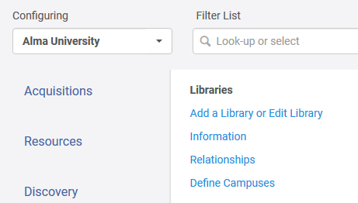
Create a dedicated library for the Quarantine Library
Create a new library at "Configuration > Configure for institution level > General > Libraries > Add a Library or Edit Library "
Institution level

Slide 7
Create a dedicated library for the Quarantine Library
In the scenario here we are creating a dedicated library which will have the location of the quarantined items of the entire institution.
Note however there is another option which we will not be doing here: Creating new dedicated quarantine locations as needed within existing libraries. If there are actual separate quarantine areas per separate libraries it may be useful to make several separate “Quarantine” locations. Otherwise it may be additional overhead.
Each institution can decide according to local needs.

Slide 8
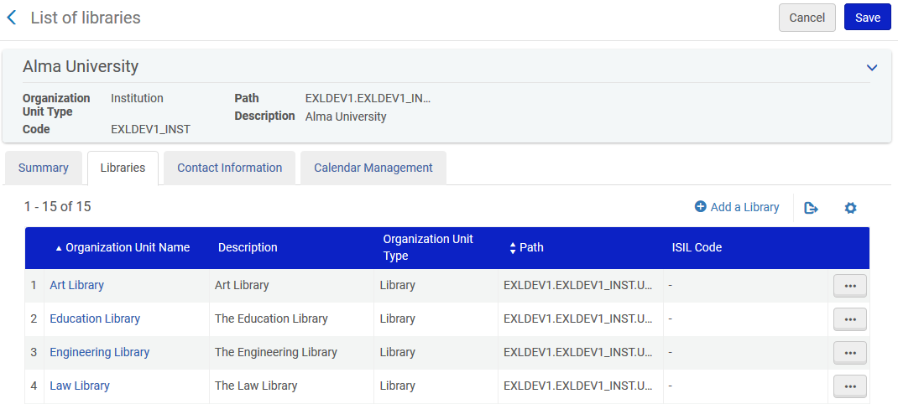
Create a dedicated library for the Quarantine Library
Add a new library

Slide 9
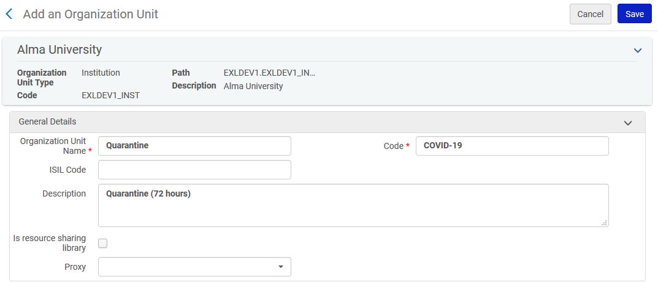
Create a dedicated library for the Quarantine Library

Slide 10
Create location for the Quarantine Library

Slide 11
Create location for the Quarantine Library
For the Quarantine Library we will create a location "Quarantine".
Here we will make it suppressed from discovery.
Later, we will also show how the item would appear in discovery if the location was not suppressed, by unchecking the option.
The location can be added at "Configuration > select the Quarantine Library > General > Locations > Physical Locations"

Slide 12
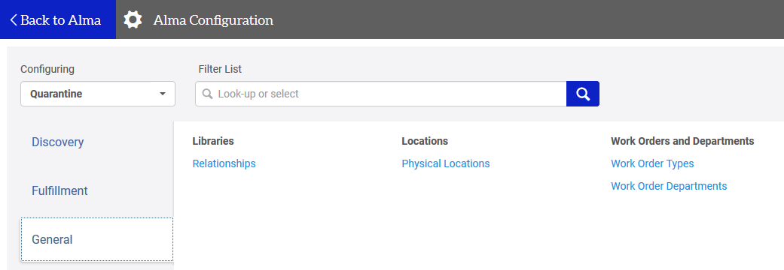
Create location for the Quarantine Library
Configuring location for the Quarantine Library

Slide 13
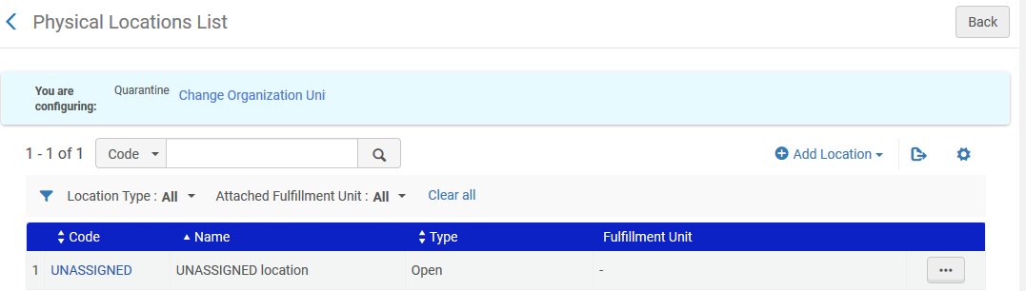
Create location for the Quarantine Library

Slide 14
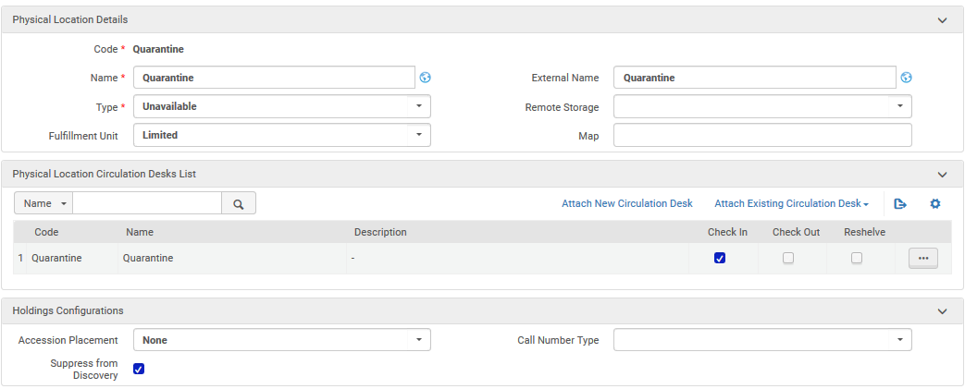
Create location for the Quarantine Library
Later we will make a fulfillment until rule for this location in this fulfillment unit not allowing loans or requests
Create a new circulation desk
Circulation desk does only check in (Make sure to also add operators to the desk)
Location is suppressed from discovery. Later for demonstrative purposes we will uncheck it.

Slide 15
The circulation desk of the suppressed location

Slide 16
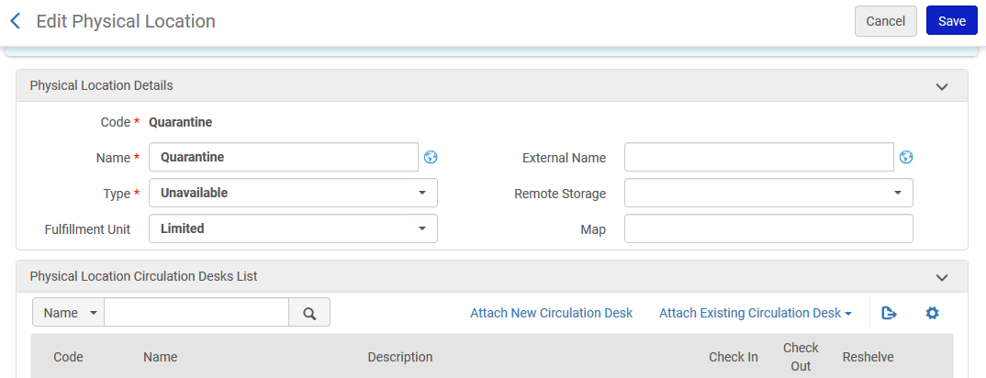
The circulation desk of the suppressed location
When we created the suppressed location we also created a corresponding circulation desk by clicking "Attach new circulation desk".

Slide 17
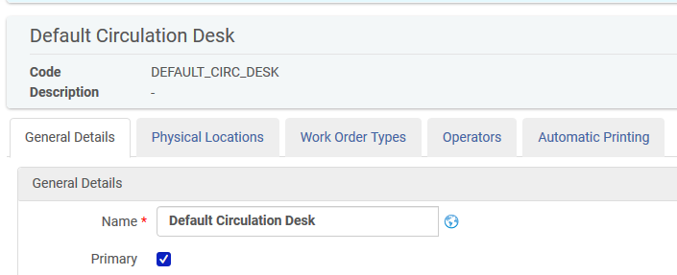
The circulation desk of the suppressed location
This will be the "Primary" and default circulation desk

Slide 18
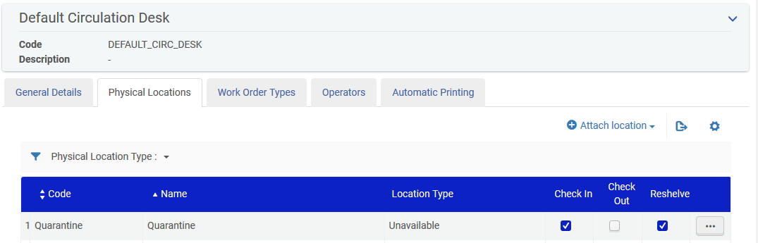
The circulation desk of the suppressed location
It will do "Check In" and "Reshelve" for the Quarantine location

Slide 19
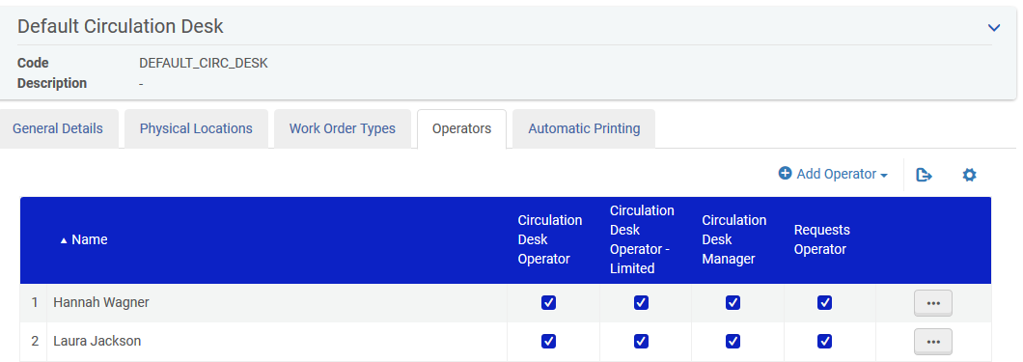
The circulation desk of the suppressed location
Add operators who will return the items straight to the Quarantine location

Slide 20
Create Fulfillment Unit Rules for the Quarantine Location

Slide 21
Create Fulfillment Unit Rules for the Quarantine Location
Theoretically (if we suppress the location) no fulfillment unit rule is needed here because the items in the Quarantine Location will not be discoverable and thus an end user cannot make a hold request.
Also the items are not on the open shelf thus an end user cannot take the item off the shelf and try to loan it.
In any case, "just to be sure" we will prevent the loaning and requesting of the items with a fulfillment unit rule.

Slide 22
Create Fulfillment Unit Rules for the Quarantine Location
At "Configuration > Fulfillment > Physical Fulfillment > Terms of Use and Policies" create a terms of use (or find an existing one) which does not allow loans.

Slide 23
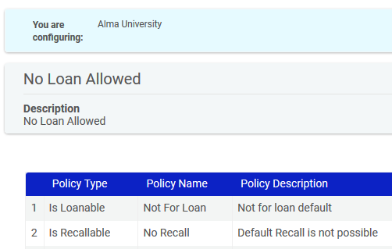
Create Fulfillment Unit Rules for the Quarantine Location

Slide 24
Create Fulfillment Unit Rules for the Quarantine Location
At "Configuration > Fulfillment > Physical Fulfillment > Terms of Use and Policies" create a terms of use (or find an existing one) which does not allow requests.

Slide 25
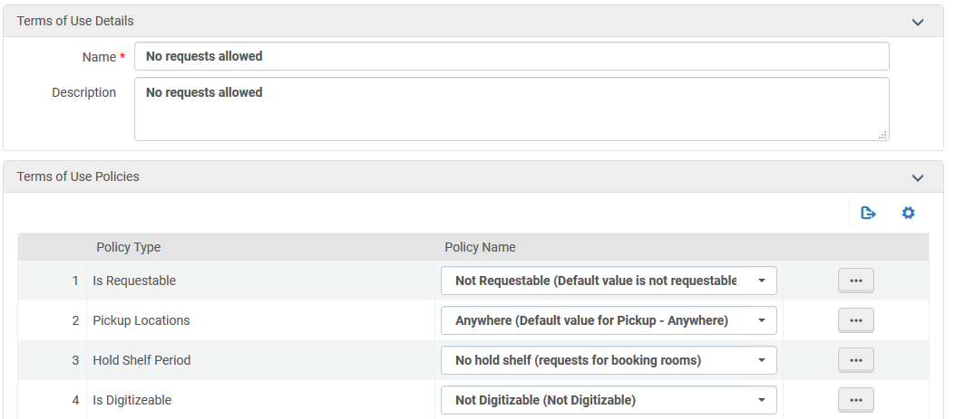
Create Fulfillment Unit Rules for the Quarantine Location

Slide 26
Create Fulfillment Unit Rules for the Quarantine Location
At "Configuration > Fulfillment > Physical Fulfillment > Fulfillment Units" edit the fulfillment unit associated with the Quarantine Library (in our case it is called "Limited") and go to the "Rules" tab.
Create a rule of type loan that states "If the location = Quarantine then use Terms of Use "No Loan Allowed"" and have it be the first rule in the list.

Slide 27
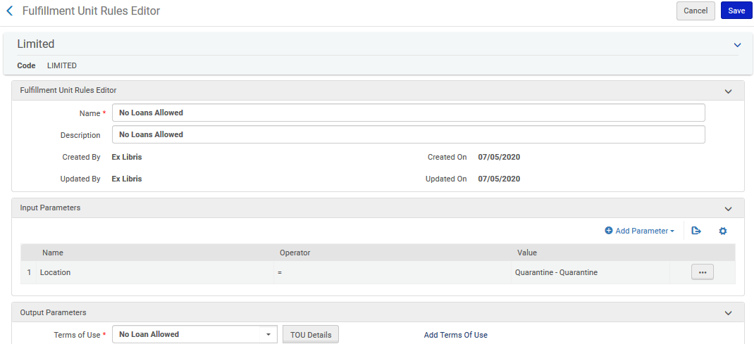
Create Fulfillment Unit Rules for the Quarantine Location

Slide 28
Create Fulfillment Unit Rules for the Quarantine Location
At "Configuration > Fulfillment > Physical Fulfillment > Fulfillment Units" edit the fulfillment unit associated with the Quarantine Library (in our case it is called "Limited") and go to the "Rules" tab.
Create a rule of type request that states "If the location = Quarantine then use Terms of Use "No Requests Allowed" and have it be the first rule in the list

Slide 29
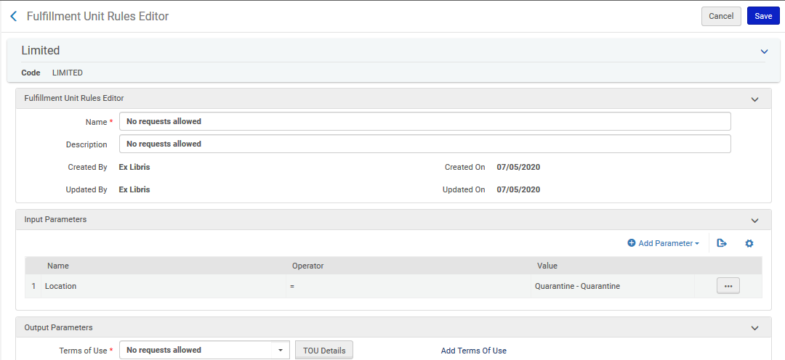
Create Fulfillment Unit Rules for the Quarantine Location

Slide 30
Return items at the Circulation Desk of the Quarantine Library

Slide 31
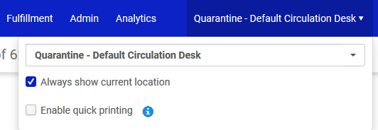
Return items at the Circulation Desk of the Quarantine Library
Staff operator who returns items chooses the default circulation desk of the Quarantine Library

Slide 32
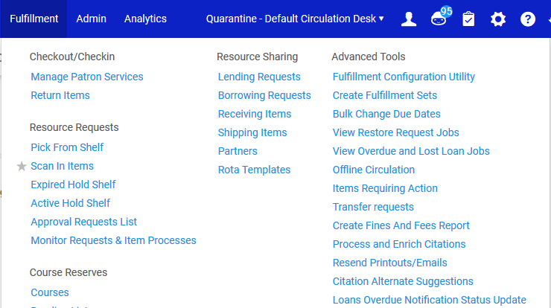
Return items at the Circulation Desk of the Quarantine Library
Use "Scan In Items" (not "Return items") to place the items in the Quarantine Location

Slide 33
Return items at the Circulation Desk of the Quarantine Library
In the "Change Information" tab:
Make the "Change Type" be temporary
Make the "Location" be "Quarantine" (or whatever the specific quarantine location is called)
Give a "due back date" of 3 days from today (or whatever the specific desired time for the item to remain in quarantine)
Scan in the barcode
Note that the fields "Change Type", "Location" and "Due Back Date" need to be chosen only once per session. They remain filled in with same values as subsequent items are scanned in.

Slide 34
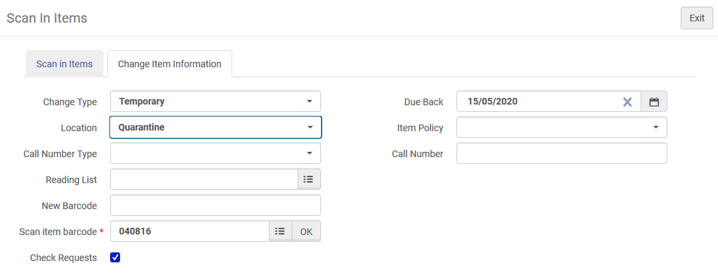
Return items at the Circulation Desk of the Quarantine Library
In the "Change Information" tab

Slide 35
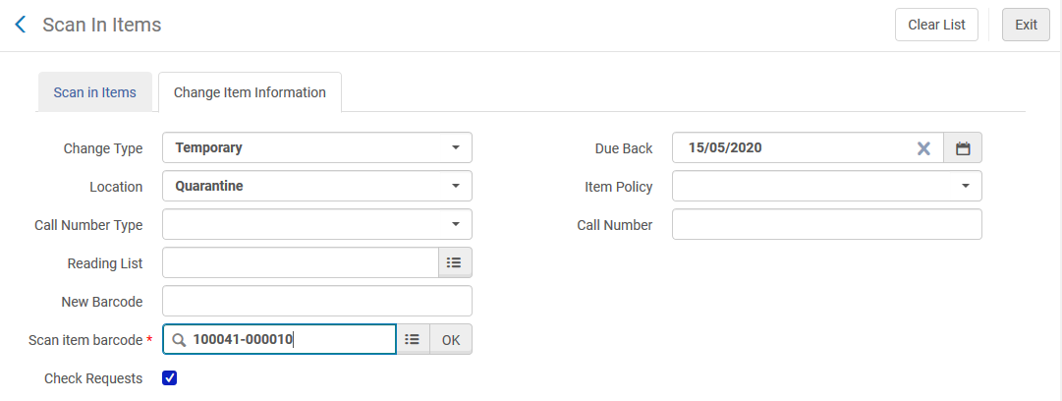
Return items at the Circulation Desk of the Quarantine Library
These fields remain and do not need to be filled in each time
Scan in the next barcode

Slide 36
Retrieving items in the Quarantine Location of the Quarantine Library

Slide 37
Retrieving items in the Quarantine Location of the Quarantine Library
Items temporarily in the Quarantine Location can be retrieved in the Alma User interface and via Alma Analytics.
On the next slide in Alma we retrieve all items temporarily in the Quarantine location

Slide 38
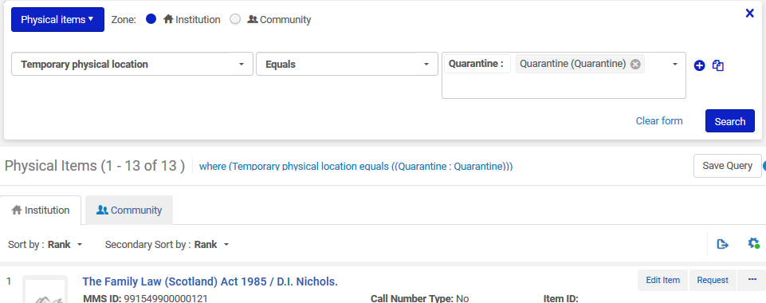
Retrieving items in the Quarantine Location of the Quarantine Library

Slide 39
Retrieving items in the Quarantine Location of the Quarantine Library
On the next slide we retrieve all items that
Are Temporarily in the Quarantine location
Have a Due Back from Temporary Location Date before 16 May 2020

Slide 40
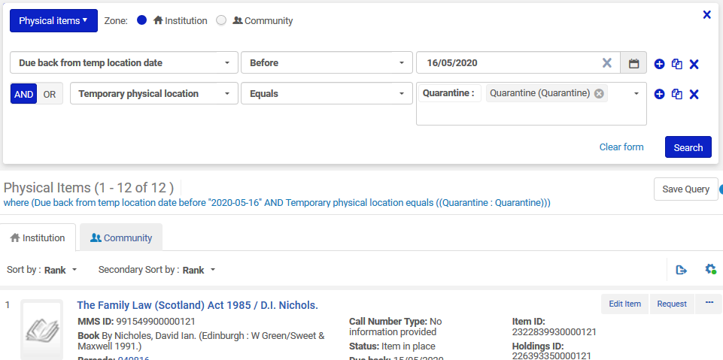
Retrieving items in the Quarantine Location of the Quarantine Library

Slide 41
Retrieving items in the Quarantine Location of the Quarantine Library
In Alma Analytics "Physical Items" subject area all items in a temporary location with a due back date can be retrieved using the
"Due Back Date" field in the "Physical Item Details" folder
"Temporary Library Name" field in the "Temporary Location" folder
"Temporary Location Name" field in the "Temporary Location" folder
Filters on these fields can be applied as desired.

Slide 42
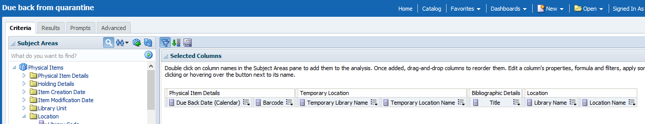
Retrieving items in the Quarantine Location of the Quarantine Library
Here is an example of the criteria tab
Here we also include the permanent location so we know later at which permanent location the items need to be received (scanned in)

Slide 43
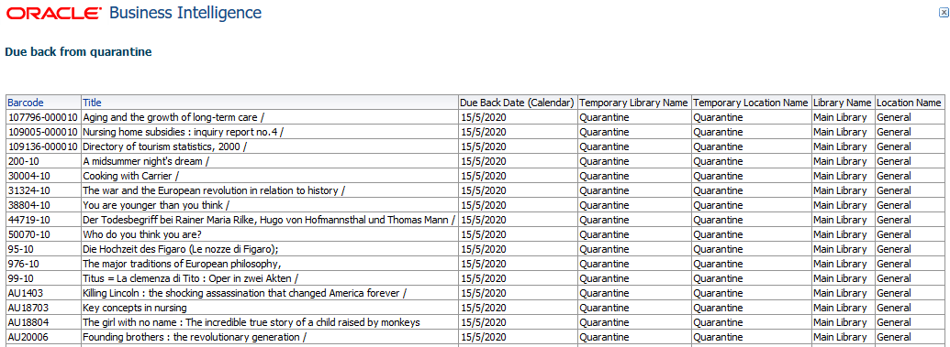
Retrieving items in the Quarantine Location of the Quarantine Library
Here is an example of the results.

Slide 44
When the item can be removed from the Quarantine Library

Slide 45
When the item can be removed from the Quarantine Library
Before we return the item from the quarantine temporary location let’s first see how it appears in Alma and Primo.
Then we can compare to how it appears after it is returned.

Slide 46
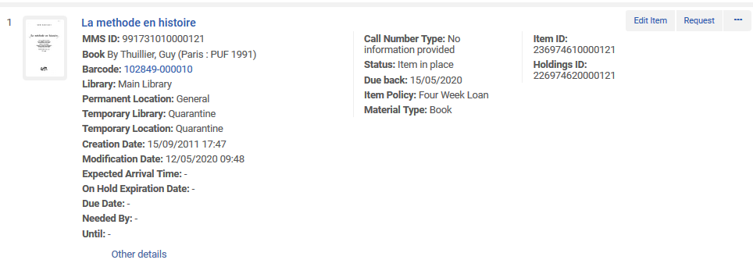
When the item can be removed from the Quarantine Library
When the item is in the temporary quarantine library it is clear to the Alma staff user, and he or she also knows when it is due back

Slide 47
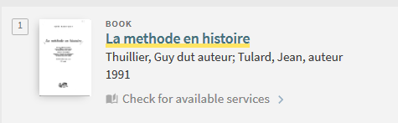
When the item can be removed from the Quarantine Library
The item is not available in Primo (because we made the location "suppressed from discovery").

Slide 48
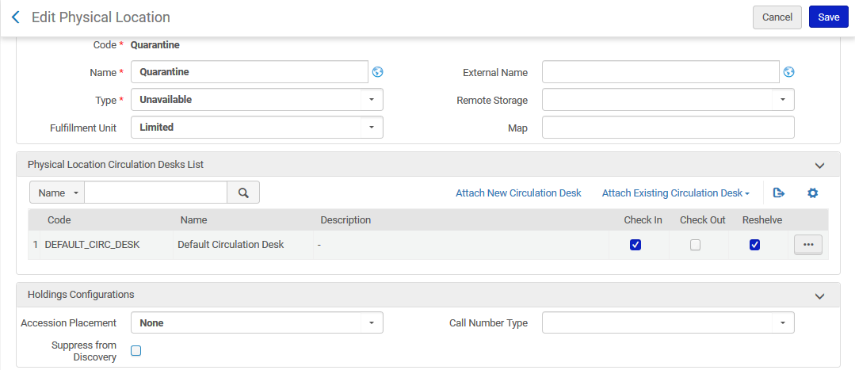
When the item can be removed from the Quarantine Library
Now we have unchecked "suppressed from discovery" for this location

Slide 49
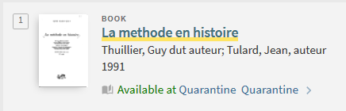
When the item can be removed from the Quarantine Library
Now the end user clearly sees in Primo that the item is in quarantine

Slide 50
When the item can be removed from the Quarantine Library
When the time comes to restore the item to permanent location the staff user can
Switch to the circulation desk of the permanent location of the item
Do "Scan in items"
Switch to the "Change item information" tab
Choose "Change Type = Restore"
Scan in the barcode

Slide 51
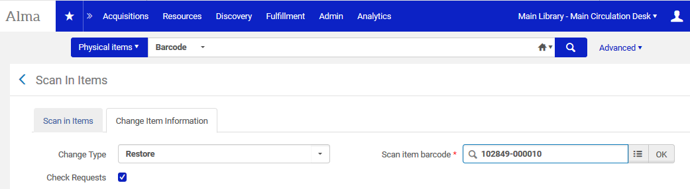
When the item can be removed from the Quarantine Library

Slide 52
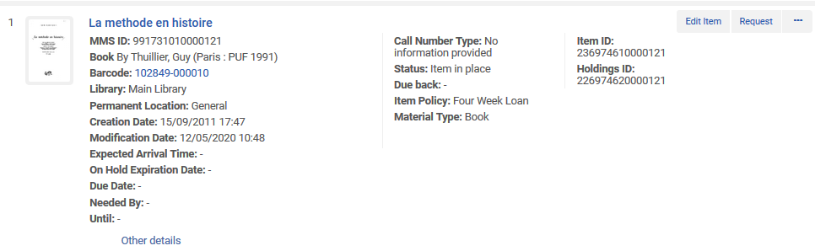
When the item can be removed from the Quarantine Library
Now the item is in place (restored to permanent location)

Slide 53
When the item can be removed from the Quarantine Library
Here it is in Alma

Slide 54
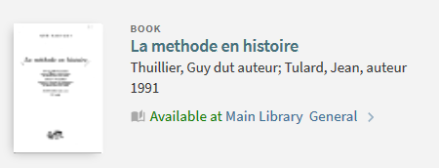
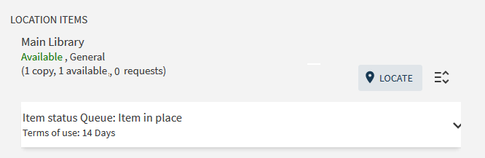
When the item can be removed from the Quarantine Library
Here it is in Primo

Slide 55
When the item can be removed from the Quarantine Library
Note: In the situation here we retrieved the items that need to be restored to the permanent location according to the "due back date" via Alma user interface and Alma Analytics.
It is also possible to run the job "Requests - Restore Temporarily Shelved Items".
This job creates restore item requests on all temporarily shelved items whose due back date is the current day or earlier. This informs the circulation desk operators at these locations to restore the items to their permanent locations.
For more information on this job, see Viewing Restore Request Jobs. For information on configuring this job, see Configuring Fulfillment Jobs.

Slide 56
Thank you!
xxx@exlibrisgroup.com

